Slide 1

Website and Mobile Application Designs | Scenario 3 | Group 21
Nkateko Malungane | Owethu Luthuli | Rorisang Manala
Notes:
Introduce the team and the project: NexArena, a gaming and esports arena in Johannesburg. Outline the four parts: design and why, logo, wireframes, demo.

Slide 2
Design and why we chose it
Dark, high-contrast base
Cyan and violet accents
Evokes a darkened gaming room and screen glow, and makes accents pop.
Energetic esports feel; the cyan-to-violet gradient marks key actions like "Book with us".
Simple, consistent navigation
Built for quick booking
Same five sections on web and mobile: Home, Packages, Fees, About, Contact.
Clear package cards, a fee calculator with discounts, and large tap targets on mobile.
Notes:
Why the designs were chosen: user-centred, dark gaming aesthetic, consistent navigation across web and mobile, quick booking and quote flow.

Slide 3
Our logo
Hexagon: esports team-badge and tech iconography
Angular "N" monogram: works alone as an app icon or favicon
Three connected dots: online multiplayer and livestreams
Bold geometric wordmark with letter-spaced tagline for legibility
#0B0E1A
#00E5FF
#B026FF
#E6E9F5
#FF2D95
Notes:
Explain the logo concept, then the palette built directly from it: Deep Space Navy, Electric Cyan, Neon Violet, Cloud White, Signal Magenta.

Slide 4
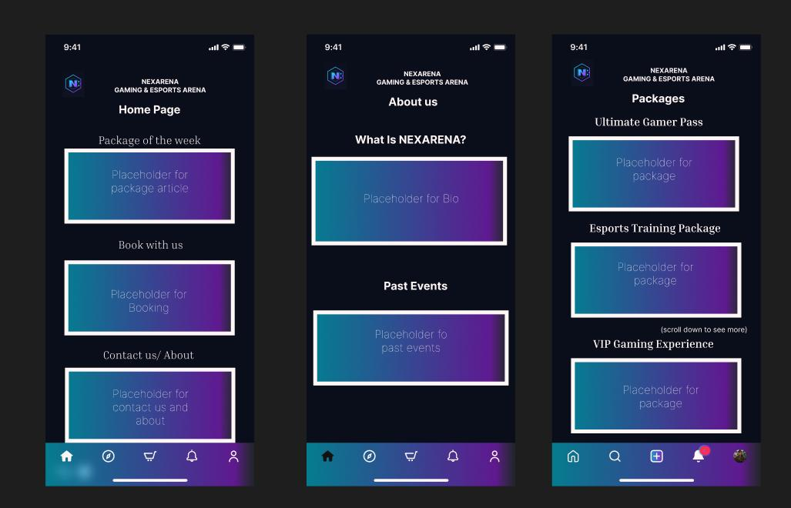
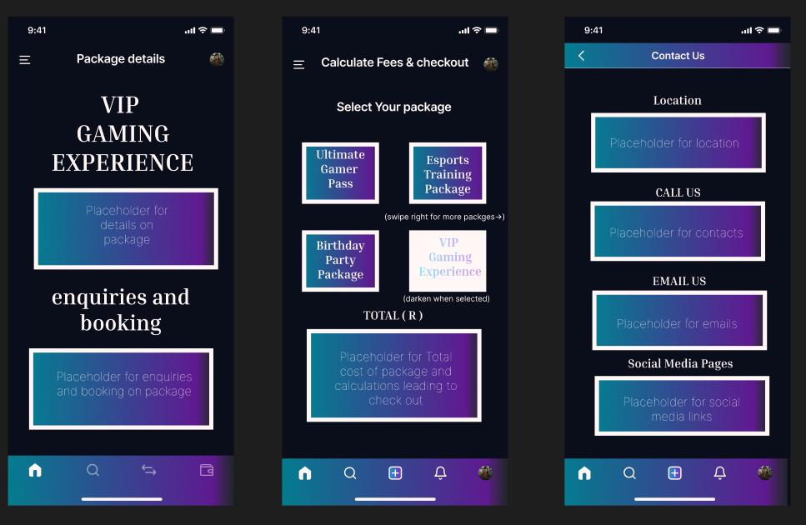
Wireframes: mobile app
Home, About us, Packages
Package details, Fees and checkout, Contact us
Bottom navigation bar and stacked content blocks keep everything reachable with one hand.
Notes:
Walk through the mobile wireframes: six screens, placeholder blocks, bottom navigation. Mention the Figma high-fidelity link.

Slide 5
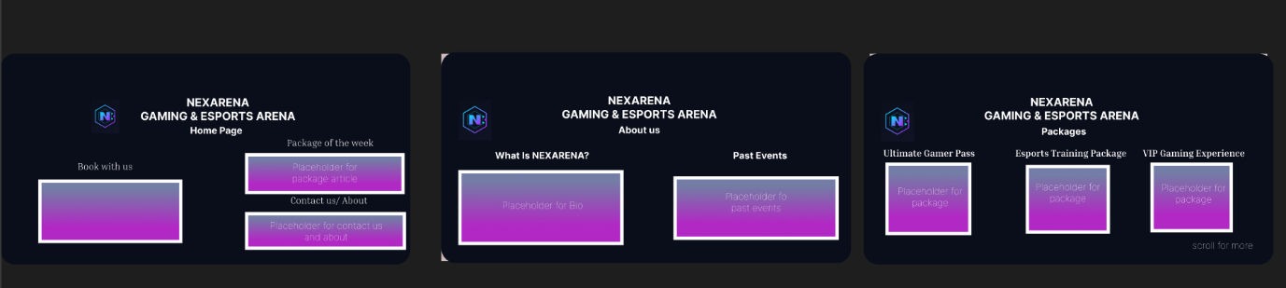
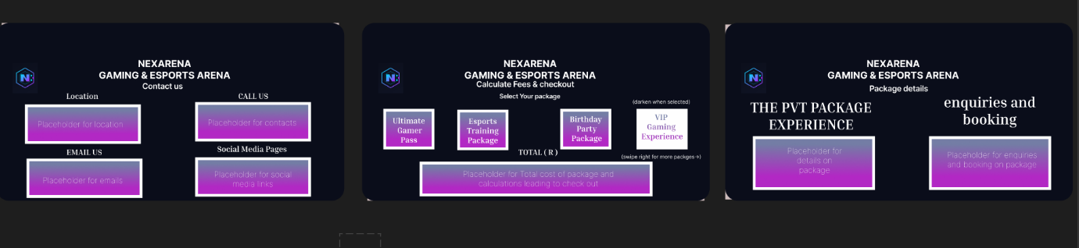
Wireframes: website
Notes:
Walk through the website wireframes: wider multi-column layouts using the same six pages and the same navigation.

Slide 6
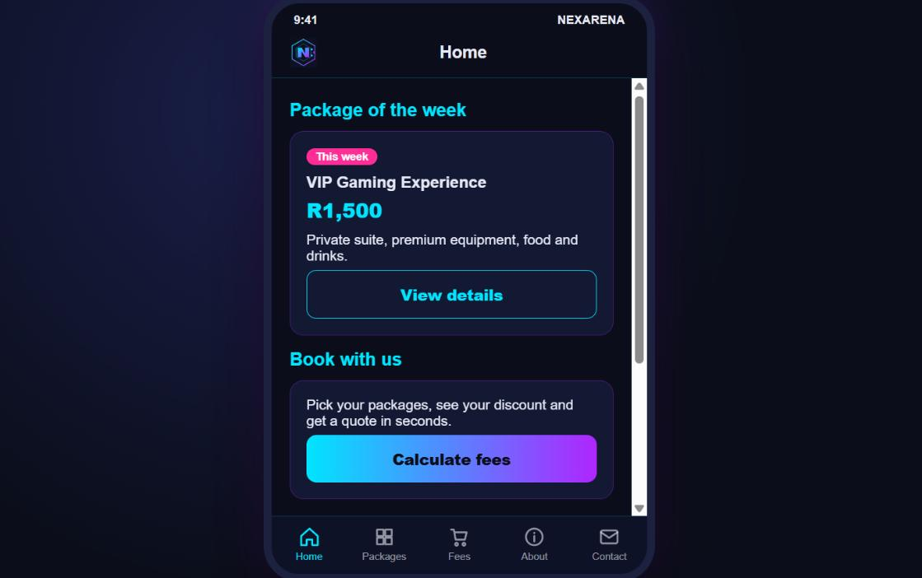
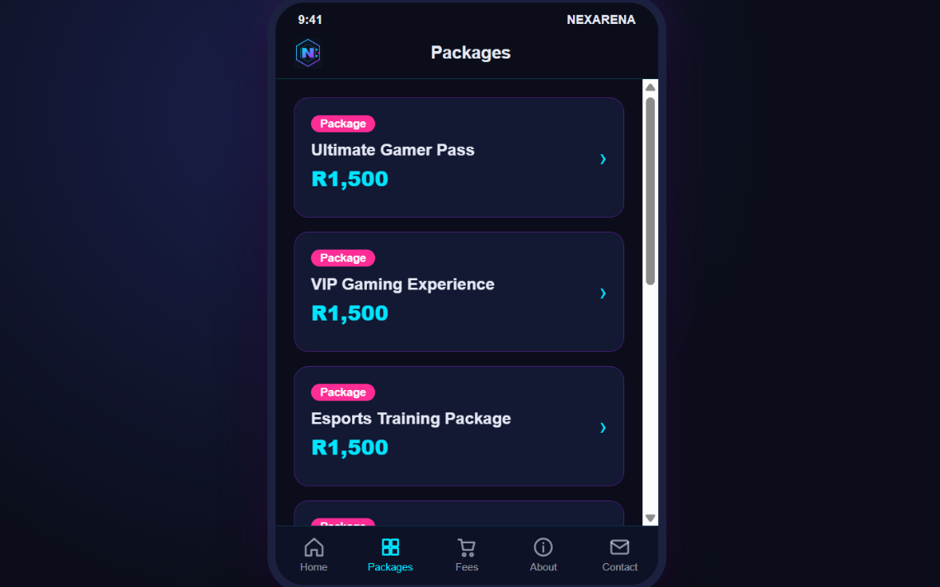
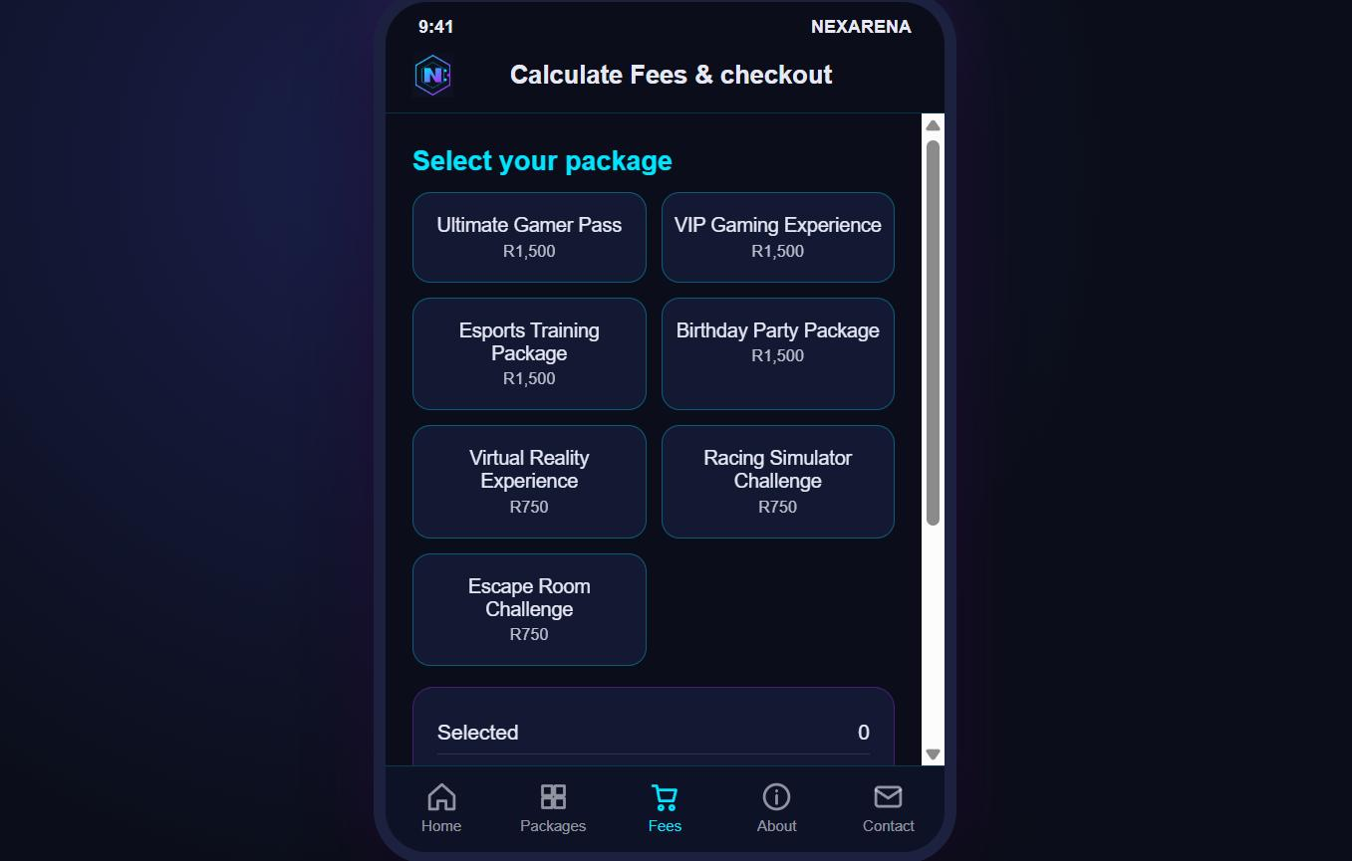
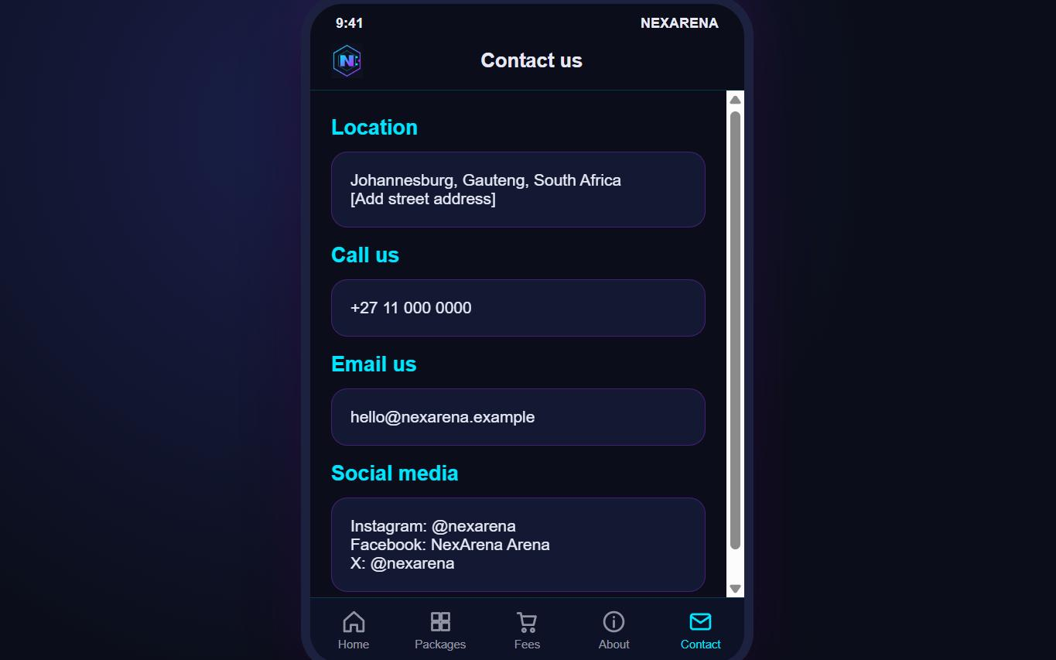
Demo: mobile version
Home
Packages
Fees
Contact
Notes:
Live demo of the mobile site: browse packages, open a package, use the fee calculator, view contact details.

Slide 7
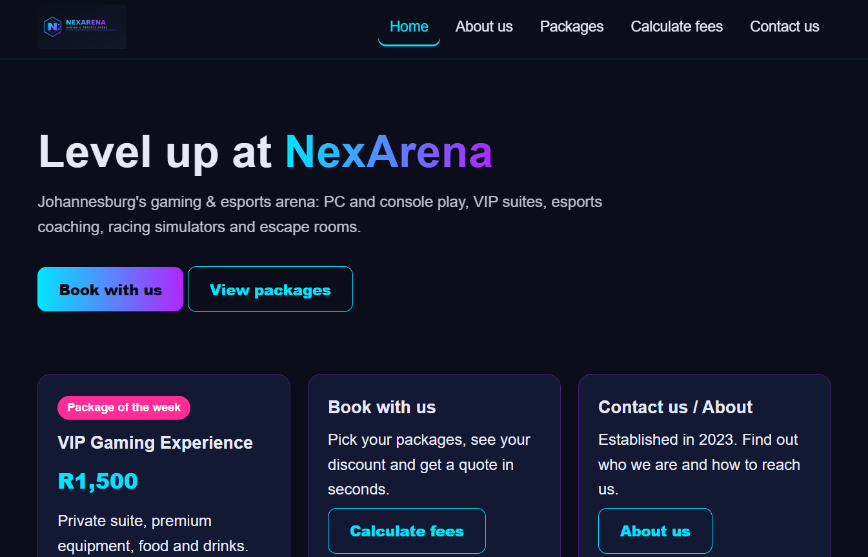
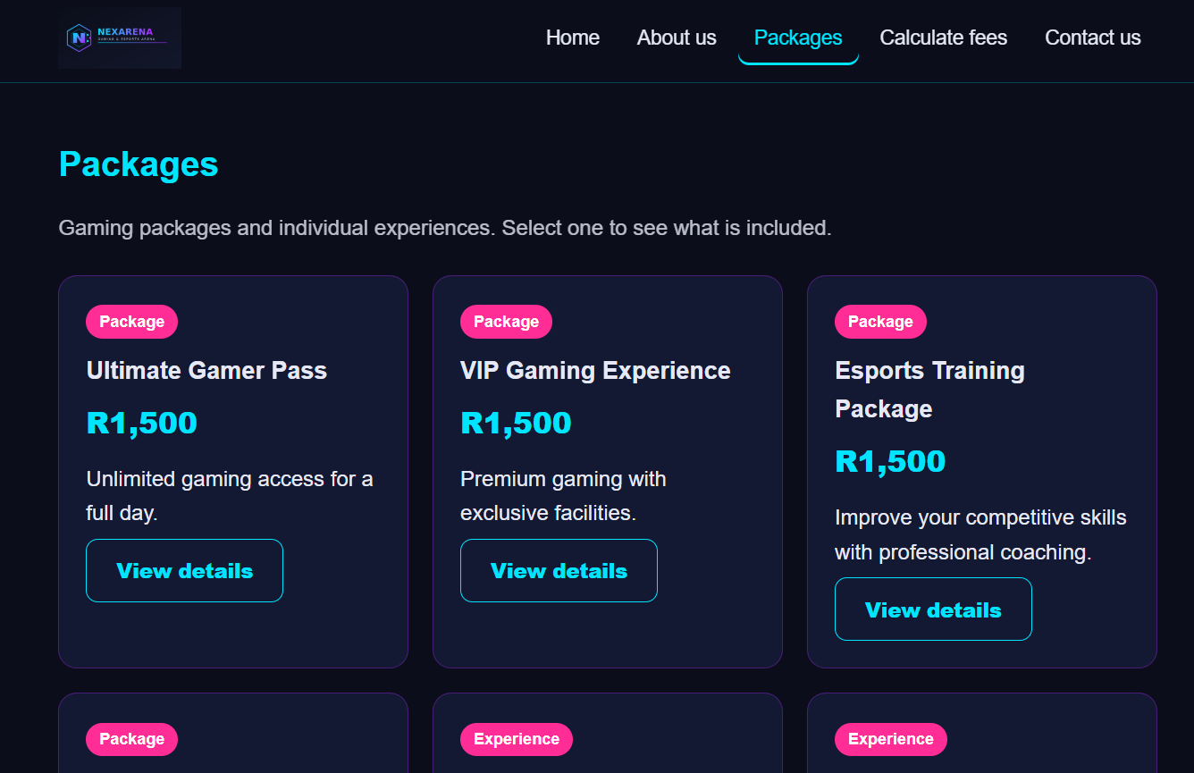
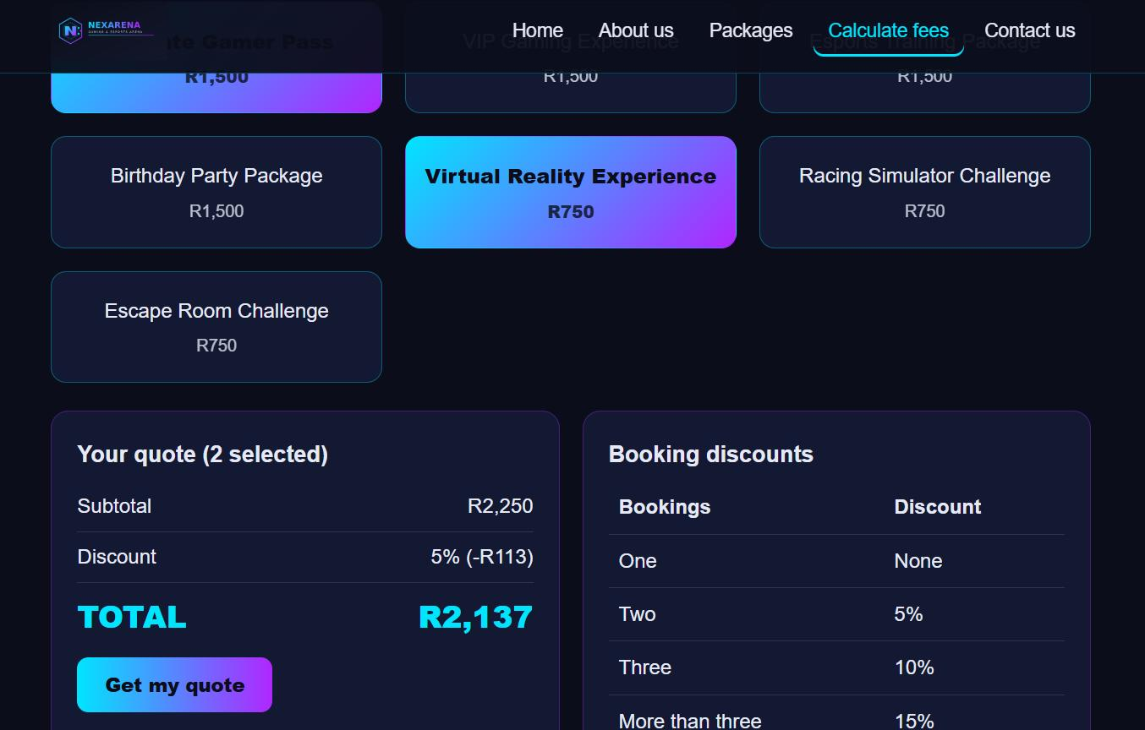
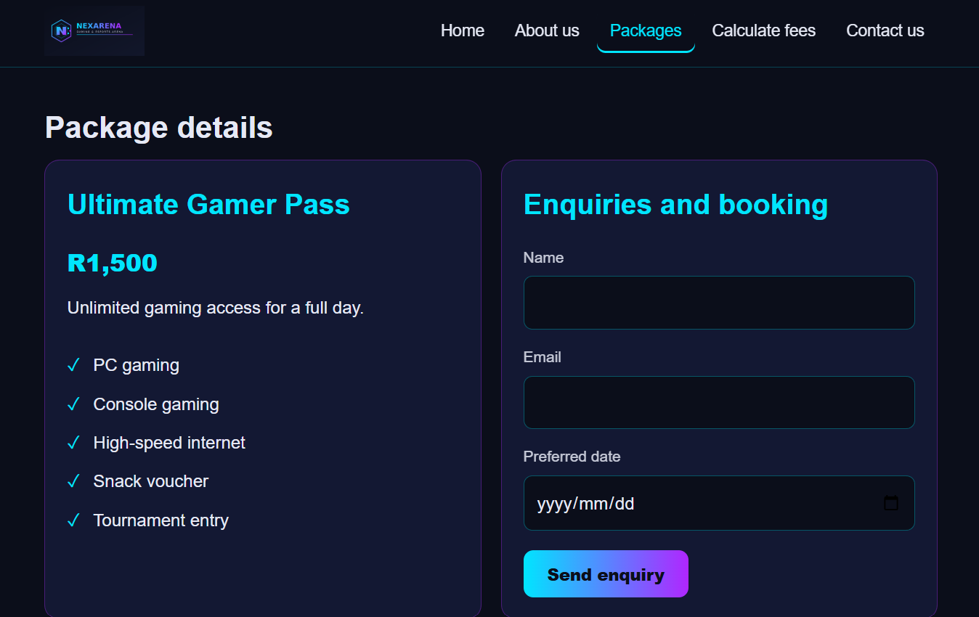
Demo: website
Home
Packages
Fee calculator and discounts
Package details and enquiry
Notes:
Live demo of the website: select packages, see the multi-booking discount (5%, 10%, 15%), send an enquiry.

Slide 8
Links and thank you
GitHub (web and mobile): github.com/shoddybeat6/nexarena-web-mobile-build
Video (unlisted YouTube): youtu.be/r-DrBOqyX9g
Figma wireframes: https://www.figma.com/design/U1MR9ExsEOsvDcxdgfRE4Q/XHAW-WIRE-FRAME?m=auto&t=pYGMGhHFJUyhjBDE-1
Thank you. Questions?

